Slide 1
Multilingual Artifacts: Bridging Cultures through Natural Language Processing"
Deep Learning for NLP
Hamza, Hardik, Ishika, Karthik, Shivam

Slide 2
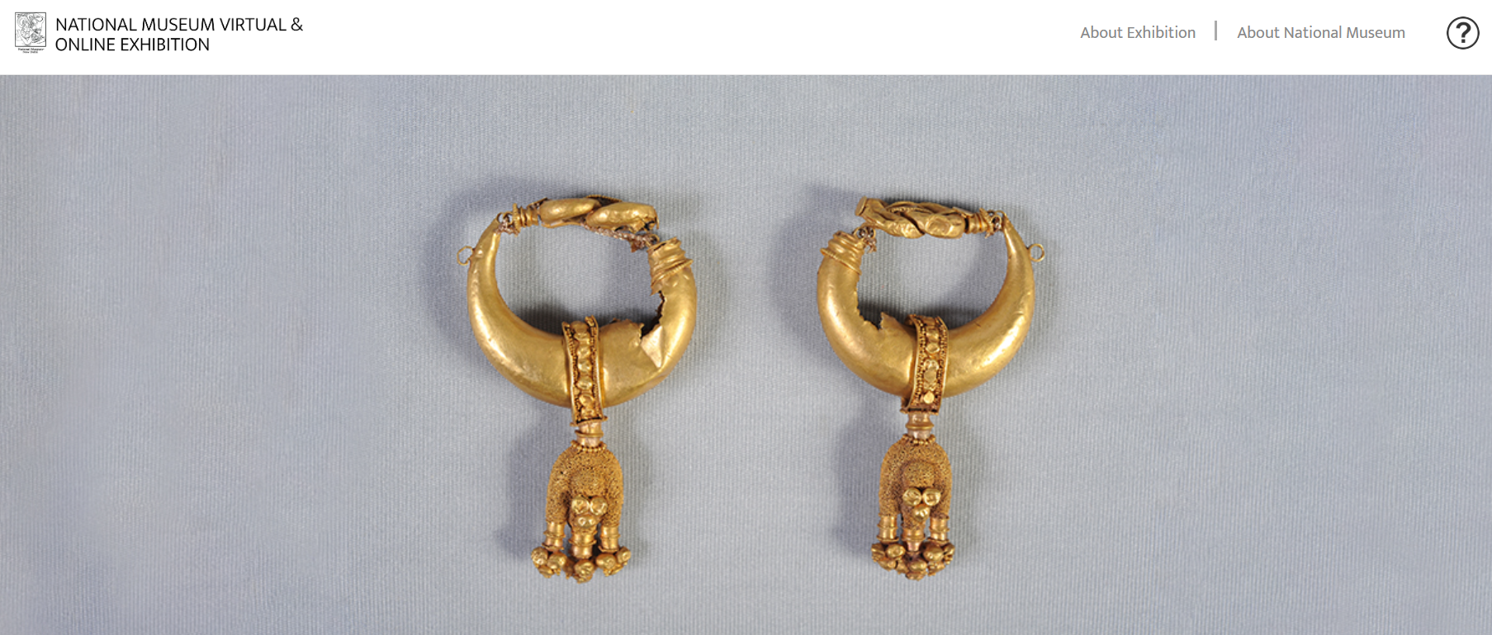
Our Idea…??
Creating a interface for viewers to engage more with museum artifacts
Challenges…!!
Data collection / Data Preprocessing/
Tamil Translation Accuracy
Work Done So Far…!! Data collection through web scrapping
Application…!! An extension of Virtual museum where viewers can satiate their curiosity in the virtual world

